Slide 1
Java & JEE Training

Slide 2
MindsMapped Training Resources
Java Training Details
Knowledge Base
Knowledge Assessment Module
Resume Preparation and Mock Interviews

Slide 3
Ice Breaking…
Expectation setting…
Bird’s eye view of the training…

Slide 4
Java & JEE Fast Track Training – Day 1 Agenda
Introduction to Java
History of Java
Salient Features of Java
Setting up Environment for Java development
Object Oriented Programming Concepts

Slide 5
Java & JEE Fast Track Training – Day 1 Agenda
Introduction to Java
History of Java
Salient Features of Java
Setting up Environment for Java development
Object Oriented Programming Concepts

Slide 6
Introduction to Java

Slide 7

Agenda
History of Java – A Programmer’s Perspective
Salient Features of Java
Major Java Editions

Slide 8
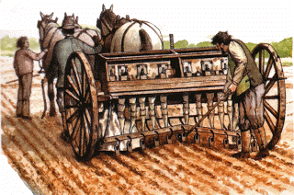
European Agricultural Revolution: 1700 onwards

Slide 9


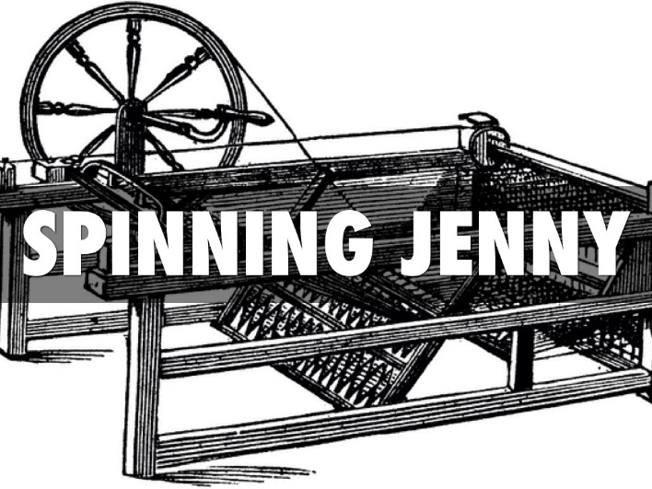
Industrial Revolution

Slide 10
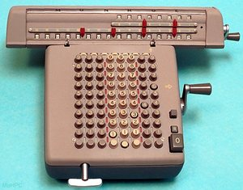
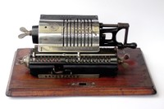

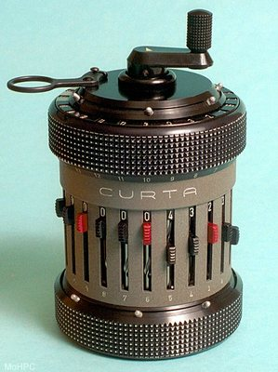
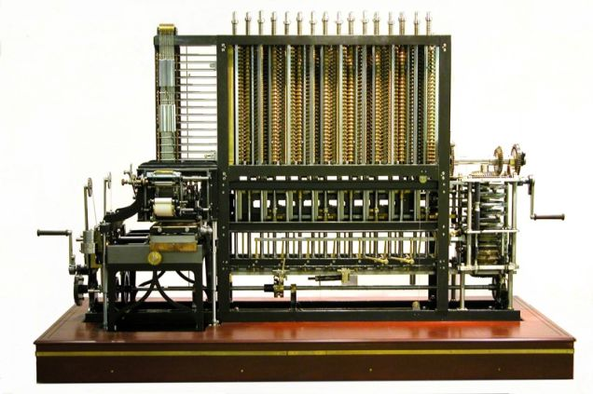
Evolution of Computer Science – initially based on mechanical systems

Slide 11
A point to ponder…
What led to the evolution of electronic computation systems?
More specifically… When we already had mechanical computing machines and calculators, what made us base the modern computing systems on electronics?

Slide 12
A point to ponder…
What led to the evolution of electronic computation systems?
More specifically… When we already had mechanical computing machines and calculators, what made us base the modern computing systems on electronics?
Switching speed.
Wear and tear.

Slide 13
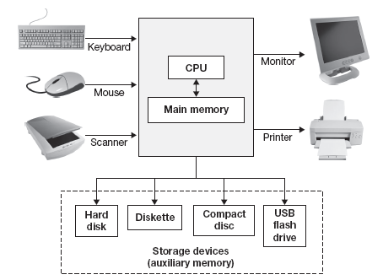
Building Blocks of a Basic Modern Computer System
Based on von Neumann architecture
John von Neumann was a Hungarian computer scientist.

Slide 14
A point to ponder…
Ok, so the CPU is the brain of the computer system. Then why do I need an OS?

Slide 15
A point to ponder…
Ok, so the CPU is the brain of the computer system. Then why do I need an OS?
Communicating with the CPU using its instruction set is cumbersome, it is difficult. We need an interpreter.

Slide 16
A point to ponder…
Ok, an OS is the interface between the user and the CPU. Then why would I need a programming language?

Slide 17
A point to ponder…
Ok, an OS is the interface between the user and the CPU. Then why would I need a programming language?
How would you add functionalities to the software that is not already available in an OS?

Slide 18
A point to ponder…
Ok, agreed I would need a programming language. Now, that we already had other languages like C for Procedural Programming, C++ for Object Oriented Programming, why did we have to write another language like Java?

Slide 19
A point to ponder…
Ok, agreed I would need a programming language. Now, that we already had other languages like C for procedural programming, C++ for Object Oriented Programming, why did we have to write another language like Java?
Necessity is the mother of invention. There is a business intent behind this invention too. But, what is that requirement?

Slide 20
The Compilation Process for Non-Java Programs (like C & C++)
Source Code (programming language instructions)
Programmers write this.
Compilers compile source code into object code.
Object Code (binary instructions)
Computers run this.

Slide 21
History of Java
In the early 1990's, putting intelligence into home appliances was thought to be the next "hot" technology.
Examples of intelligent home appliances:
Coffee pots and lights that can be controlled by a computer's programs.
Televisions that can be controlled by an interactive television device's programs.
Anticipating a strong market for such things, Sun Microsystems in 1991 funded a research project (code named Green) whose goal was to develop software for intelligent home appliances.
An intelligent home appliance's intelligence comes from its embedded processor chips and the software that runs on the processor chips.
Appliance processor chips change often because engineers continually find ways to make them smaller, less expensive, and more powerful.
To handle the frequent turnover of new chips, appliance software must be extremely portable.

Slide 22
The Issue of Portability
A piece of software is portable if it can be used on many different types of computers.
Object code is not very portable. As you know, object code is comprised of binary-format instructions. Those binary-format instructions are intimately tied to a particular type of computer. If you've got object code that was created on a type X computer, then the object code can run only on a type X computer.
The Java solution to improve portability:
Java compilers don't compile all the way down to object code. Instead, they compile down to bytecode, which possesses the best features of both object code and source code:
Like object code, bytecode uses a format that works closely with computer hardware, so it runs fast.
Like source code, bytecode is generic, so it can be run on any type of computer.

Slide 23
The Compilation Process for Java Programs
Java source code
Java compilers compile source code into bytecode.
bytecode
When a Java program is run, the JVM translates bytecode to object code.
object code

Slide 24
Java Virtual Machine
How can bytecode be run on any type of computer?
As a Java program’s bytecode runs, the bytecode is translated into object code by the computer's bytecode interpreter program. The bytecode interpreter program is known as the Java Virtual Machine, or JVM for short. The JVM is written specifically for every platform.

Slide 25
Issue of Portability Solved.. But..
Originally, Sun planned to use C++ for its home appliance software, but they soon realized that C++ was less than ideal because it wasn't portable enough and it relied too heavily on hard-to-maintain things called pointers.
Thus, rather than write C++ software and fight C++'s inherent deficiencies, Sun decided to develop a whole new programming language to handle its home appliance software needs.
Their new language was originally named Oak (for the tree that was outside project leader James Gosling's window), but it was soon changed to Java.
When the home appliance software work dried up, Java almost died before being released.
Fortunately for Java, the World Wide Web exploded in popularity and Sun realized it could capitalize on that.

Slide 26
Issue of Portability Solved.. But..
Web pages have to be very portable because they can be downloaded onto any type of computer.
What's the standard language used for Web pages?
Java programs are very portable and they're better than HTML in terms of providing user interaction capabilities.
Java programs that are embedded in Web pages are called applets.
Although applets still play a significant role in Java's current success, some of the other types of Java programs have surpassed applets in terms of popularity.
In this course, we cover Standard Edition (SE) Java applications. They are Java programs that run on a standard computer – a desktop or a laptop, without the need of the Internet.

Slide 27
Features Of Java
Simple
Similar to C and C++, but without the demerits…
Omits operator overloading, multiple inheritance
Goto statement is eliminated
Header files are eliminated
No concept of pointers
Automatic Garbage collection
A rich set of predefined classes

Slide 28
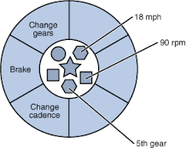
Features Of Java
Object-Oriented
Forces the programmer to use the classes and object
Class
Member variables( data ) and member functions ( methods )

Slide 29
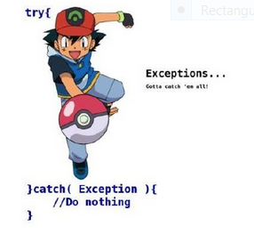

Features Of Java
Robust
designed for writing highly reliable or robust software:
automatic garbage collection, which prevents memory leaks
Type safety of data
Extensive compile time and runtime checking
Object Oriented Exception Handling of run time errors
Divide by zero exception.

Slide 30
JVM
JIT
Hello.java(10) .exe (binary)
Hello.java(15)
Looping (inner statement
INTERPRETER

Slide 31
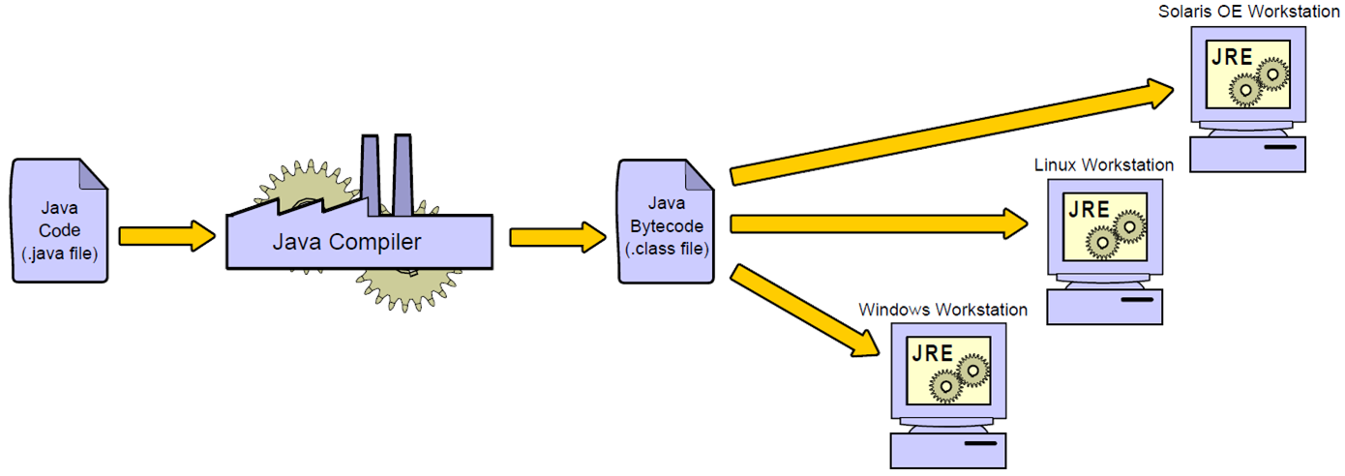
Features Of Java
Architectural Neutral and Interpreted
compiler generates bytecodes
Easy to interpret on any machine
“Write once and run anywhere WORA”

Slide 32
Features Of Java
Powerful
Networking
Threads
Distributed Objects
Database Access
Graphics
Data structure library
Serialization
Digital Signatures

Slide 33
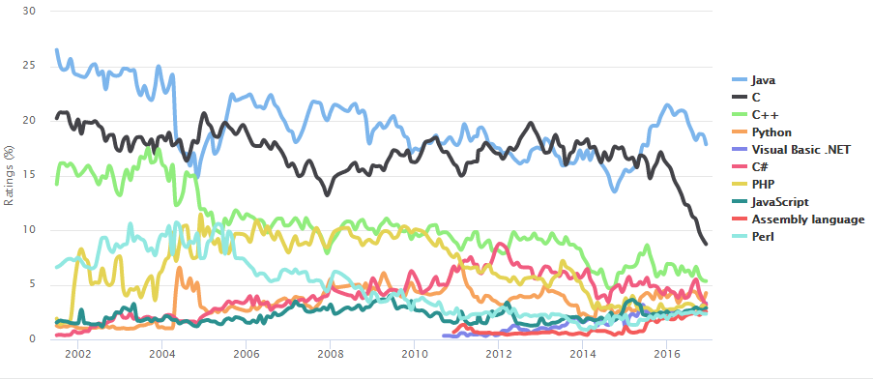
Features Of Java
Java is Popular

Slide 34
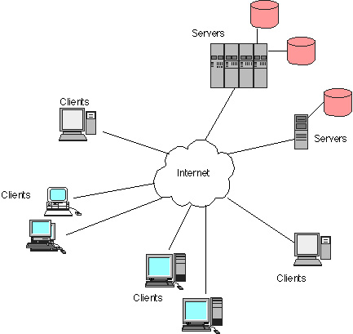
Features Of Java
Distributed
Supports TCP/IP
Remote Method
Invocation (RMI)
Web Services

Slide 35
Features of Java
Multi-Threaded
Parallel processing to improve the performance of certain types of programs

Slide 36
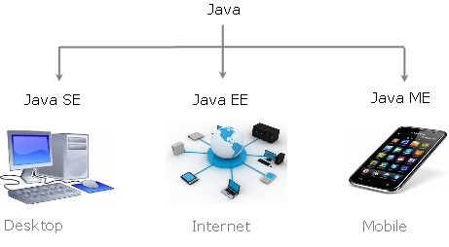
Major Java Editions

Slide 37
Java & JEE Fast Track Training – Day 1 Agenda
Introduction to Java
History of Java
Salient Features of Java
Setting up Environment for Java development
Object Oriented Programming Concepts

Slide 38
Setting up environment for Java Development

Slide 39
Steps for Environment Setup
Download and install latest JDK from Oracle site
Download and install Eclipse

Slide 40
Download latest JDK from Oracle site
"JDK" or "JRE"?
JRE (Java Runtime) is needed for running Java programs. JDK (Java Development Kit), which includes JRE plus the development tools (such as compiler and debugger), is need for writing as well as running Java programs. Since you are supposed to write Java Programs, you should install JDK, which includes JRE.
To download and install JDK follow the steps in the following slides.

Slide 41
Download latest JDK from Oracle site – Step 0
Step 0: Un-Install Older Version(s) of JDK/JRE
I recommend that you install only the latest JDK. Although you can install multiple versions of JDK concurrently, it is messy.
If you have previously installed older version(s) of JDK/JRE, un-install ALL of them. Goto "Control Panel" ⇒ "Program and Features" ⇒ Un-install ALL programs begin with "Java", such as "Java SE Development Kit ...", "Java SE Runtime ...", and etc.

Slide 42
Download latest JDK from Oracle site – Step 1
Step 1: Download JDK
Goto Java SE download site @ http://www.oracle.com/technetwork/java/javase/downloads/index.html
Under "Java Platform, Standard Edition" ⇒ "Java SE 8u{xx}", where {xx} is the latest update number ⇒ Click the "JDK Download" button.
Check "Accept License Agreement".
Choose your operating platform, e.g., "Windows x64" (for 64-bit Windows OS) or "Windows x86" (for 32-bit Windows OS). You can check whether your Windows OS is 32-bit or 64-bit via "Control Panel" ⇒ "System" ⇒ Under "System Type".

Slide 43
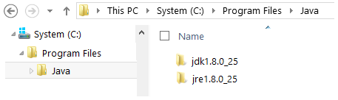
Download latest JDK from Oracle site – Step 2
Step 2: Install JDK and JRE
Run the downloaded installer (e.g., "jdk-8u{xx}-windows-x64.exe"), which installs both the JDK and JRE. By default, the JDK will be installed in directory "C:\Program Files\Java\jdk1.8.0_xx", where xx denotes the latest upgrade number; and JRE in "C:\Program Files\Java\jre1.8.0_xx".
For novices, accept the defaults. Follow the screen instructions to install JDK and JRE.
Check the JDK installed directory by inspecting these folders using File Explorer. Take note of your JDK installed directory, which you will need in the next step.
I shall refer to the installation directory as <JAVA_HOME>

Slide 44
Download latest JDK from Oracle site – Step 3
Step 3: Include JDK's "bin" Directory in the PATH
Windows OS searches the current directory and the directories listed in the PATH environment variable for executable programs. JDK's programs (such as Java compiler javac.exe and Java runtime java.exe) reside in directory "<JAVA_HOME>\bin" (where <JAVA_HOME> denotes the JDK installed directory). You need to include "<JAVA_HOME>\bin" in the PATH to run the JDK programs.
To edit the PATH environment variable in Windows XP/Vista/7/8/10:
Launch "Control Panel" ⇒ "System" ⇒ Click "Advanced system settings".
Switch to "Advanced" tab ⇒ "Environment Variables".
Under "System Variables", scroll down to select "Path" ⇒ "Edit...".
(CAUTION: Read this paragraph 3 times before doing this step! There is no UNDO)
For Windows 10: You see a table listing the existing PATH entries. Click "New" ⇒ Enter the JDK's binary directory "c:\Program Files\Java\jdk1.8.0_xx\bin" (Replace xx with your installation's upgrade number!!!) ⇒ Select "Move Up" to move it all the way to the top.
Prior to Windows 10: In "Variable value" field, INSERT "c:\Program Files\Java\jdk1.8.0_xx\bin" (Replace xx with your installation upgrade number!!!) IN FRONT of all the existing directories, followed by a semi-colon (;) which separates the JDK's binary directory from the rest of the existing directories. DO NOT DELETE any existing entries; otherwise, some existing applications may not run.

Slide 45
Download latest JDK from Oracle site – Step 4
Step 4: Verify the JDK Installation
Launch a CMD shell (Click "Start" button ⇒ run... ⇒ enter "cmd"; OR from "Start" button ⇒ All Programs ⇒ Accessories ⇒ Command Prompt).
Issue "path" command to list the contents of the PATH environment variable. Check to make sure that your <JAVA_HOME>\bin is listed in the PATH.
// Display the PATH entries
prompt> path
PATH=c:\Program Files\Java\jdk1.8.0_xx\bin;[other entries...]
Don't type prompt>, which denotes the command prompt!!! Key in the command (highlighted) only.
Issue the following commands to verify that JDK/JRE are properly installed and display their version:
// Display the JRE version
prompt> java -version
java version "1.8.0_xx"
Java(TM) SE Runtime Environment (build 1.8.0_xx-b13)
Java HotSpot(TM) 64-Bit Server VM (build 25.5-b02, mixed mode)
// Display the JDK version
prompt> javac -version
javac 1.8.0_xx

Slide 46
Download and Install Eclipse
Download Eclipse from: http://www.eclipse.org/downloads/packages/release/Neon/2
* Neon is the latest Eclipse release as of today. You can download the latest Eclipse release.
To install, all you have to do is extract the zip folder.
While starting Eclipse, choose a workspace to store all your project files.
Once Eclipse is launched, point it to the JDK you installed earlier
Preferences -> Java -> Installed JRE's

Slide 47
Java & JEE Fast Track Training – Day 1 Agenda
Introduction to Java
History of Java
Salient Features of Java
Setting up Environment for Java development
Object Oriented Programming Concepts

Slide 48
Java Language Fundamentals – OOP Fundamentals

Slide 49
JAVA FUNDAMENTALS
Quick review of some important concepts
History of Java
JDK and JRE
Byte Code and JVM (Java Virtual Machine)
Platform Independence
Applications and Applets
Principles of Object Oriented Programming
First Java Application

Slide 50
History of Java - Milestones
1990→ Sun Microsystems decided to develop special software that could be used to manipulate consumer electronic devices. A team of Sun Microsystems programmers headed by James Gosling was formed to undertake this task.
1991→ After exploring the possibility of most Object Oriented Programming Language C++, the team announced a new language named “Oak”.
1992→ The team, known as a Green Project team by Sun, demonstrated the application of their new language to control a list of home appliances using a hand-held device with a tiny touch sensitive screen.
1993→ The World Wide Web(WWW) appeared on the internet and transformed the text-based Internet into a Graphical-rich environment. The green Project team came up with the idea of developing Web Applets(tiny programs) using the new language that could run on all types of computers connected to Internet.
1994→ The team developed a web browser called “Hot Java” to locate and run applet programs on Internet. Hot Java demonstrated the power of the new language, thus making it instantly popular among the Internet users.
1995→ Oak was named “Java”, due to some legal snags. Java is just a name and is not an acronym. Many popular companies including Netscape and Microsoft announce to their support to Java.
1996→ Java established itself not only a leader for Internet Programming but also as a general-purpose, object oriented programming language. Java found its home.

Slide 51
Java - Features
The most striking feature of the language is that it is a platform-neutral language. Java is a first programming language that is not tied to any particular hardware or operating system.
Features of Java :
Compiled and Interpreted.
Platform-Independent and Portable
Object-Oriented
Robust and Secure
Distributed
Familiar, Simple and Small
Multithreaded and Interactive
High Performance
Dynamic and Extensible

Slide 52
JDK & JRE
Java Environment includes a large number of development tools and hundreds of classes and
methods. The development tools are part of the system known as Java Development Kit(JDK) and the classes and methods are part of the Java Standard Library (JSL), also known as the Application Programming Interface (API).
JDK : Java Development Kit comes with a collection of tools that are used for developing and
running Java Programs. They include :
appletviewer-> Enables us to run Java Applets (Without using java compatible browser)
Java→ Java Interpreter, which runs applets and applications by reading and interpreting bytecode
files.
Javac→ The Java compiler, which translates Java source code to byte code files that the
interpreter understad.
Javadoc→ Creates HTML-format documentation from Java source code files.
Javah→ Produces header files for use with native methods.
javap→ Java disassembler, which enables us to convert bytecode files into a program
description.
Jdb→ Java debugger, which helps us to find errors in our programs.

Slide 53
Byte Code & JVM(Java Virtual Machine)
Since platform-independence is a defining characteristic of Java, it is important to understand
how it is achieved. Programs exist in two forms; source code and object code. Source Code is
the textual version of the program that you write using a text editor. The programs printed in a
book are shown as source code. The executable form of a program is object code. The computer
can execute object code. Typically, object code is specific to a particular CPU. Therefore, it
cannot be executed on a different platform. Java removes this feature in a very elegant manner.
Like all computer languages, a java program begins with its source code. The difference is
what happens when a Java program is compiled. Instead of producing executable code, the Java
Compiler produces an object file that contains bytecode. Bytecodes are instructions that are not
for any specific CPU. Instead, they are designed to be interpreted by a Java Virtual Machine
(JVM). The key to Java’s platform-independence comes from the fact that the same bytecodes
can be executed by any JVM on any platform. As long as there is a JVM implemented for a a
given environment, it can run any Java program. For example, Java programs can execute under
Windows 98,Solaris,IRIX, or any other platform for which a JVM can be implemented for that
platform. This would then allow any Java program to execute in that new environment.

Slide 54
Platform Independent
Compilation is the process of converting the code that you type into a language
that the computer understands-machine language. When you compile a
program, the compiler checks for syntactical errors in code and lists all the
errors on the screen. You have to rectify the errors and recompile the program
to get the machine language code. The Java compiler compiles the code to
bytecode that is understood by the Java environment.
The bytecode is the result of compiling a Java program. You can execute this
code on any platform. In other words, due to the bytecode compilation process
and interpretation by a browser, Java programs can be executed on a variety of
hardware and operating systems. The only requirement is that the system
should have a java-enabled Internet browser. The java compiler is written in
Java, and the interpreter is written in C. The Java Interpreter can execute Java
Code directly on any machine on which a Java interpreter has been installed.

Slide 55
Java Compiler and Interpreter
Java Program
Java Compiler
Virtual Machine
Source Code
Bytecode
Process of Compilation
Bytecode
Java Interpreter
Machine Code
Virtual Machine
Real Machine
Process of Converting bytecode into machine code

Slide 56
Application and Applets
There are two types of programs that can be built in Java Applications and applets.
Applications can be directly executed by a JVM. In fact, Java can be used to develop
programs for all kinds of applications, Hot Java itself is a Java Application program.
Applets are small Java programs developed for Internet Applications. An applet located
on distant computer (Server) can be downloaded via Internet and executed on a local
computer (Client) using a Java enabled browser. We can develop applets for doing
everything from simple animated graphics to complex games and utilities. Since applets
are embedded in an HTML document and run inside a Web Page, creating and running
applets are more complex than creating application. Stand alone program can read and
write files and perform certain operations that applet can not do. An Applet can only run
within a Web Browser. The Web browser includes a JVM that provides an execution
environment for the applet. It is also possible to use a tool called the appletviewer to
run an applet. This utility is included in the Java Development Kit(JDK) and is used to
test applets. In this manner, an applet written by any developer in the world may be
dynamically downloaded from the Web Server and executed on a client PC or
workstation.

Slide 57
Java Source Code
Java Bytecode
Application Type
Applet Type
Java Enabled Browser
Java Interpreter
Output
Output

Slide 58
Principles of Object Oriented Programming
Object Oriented Programming (OOP) attempts to emulate the real world in software systems.
The real world consists of objects, categorized in classes. In Object Oriented Programming,
classes have attributes, represented by data member. The attributes distinguish an object of
the class. Classes have behaviors, which are represented by methods. The methods define
how an object acts or reacts.
Features of Object Oriented Programming :
Information Encapsulation(Hiding) :- Objects provide the benefit of information hiding.
Electrical wiring in a television should not be tempered with, and therefore should be hidden
from the user. Object Oriented programming allows you to encapsulate data that you do not
want users of the object to access. Typically, attributes of a class are encapsulated.
Abstraction :- Abstraction allows us to focus on only those parts of an object that concern
us. Person operating the television does not need to know the intricacies of how it works. The
person just needs to know how to switch it on, change channels, and adjust the volume. All
the details that are unnecessary to users are encapsulated, leaving only a simple interface to
interact with. Providing users with only what they need to know is known as abstraction. i.e.
Abstraction lets us ignore the irrelevant details and concentrate on the essentials.

Slide 59
Principles of Object Oriented Programming
Inheritance :- Inheritance is the process by which objects of one class acquire the properties of objects of another class. Inheritance supports the concept of hierarchical classification. In OOP, the concept of inheritance provides the idea of reusability. This means that we can add additional features to an existing class without modifying it. This is possible by deriving a new class from the existing one. The new class will have the combined features of both the classes.
Polymorphism :- Polymorphism means “One Interface, multiple implementations.”
Shape
Ellipse
Rectangle
Triangle
The class Shape defines a method called getArea() that returns the area of a shape. However, this method is not implemented by that class. Therefore, it is an abstract method and Shape is an abstract class.
This means that no objects of class Shape can be created. However, the functionality of that class can be inherited by its subclass. The various subclasses of Shape like Ellipse, Rectangle, Triangle do implement the getArea() method.

Slide 60
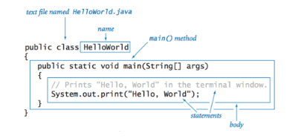
First Java Application
Create the File
The first step to create the HelloWorld application is to copy the text below into a file called HelloWorld.java using your favorite text editor.
It is very important to call the file HelloWorld.java, because the compiler expects the file name to match the class identifier

Slide 61
Class Declaration
The first line public class HelloWorld declares a class, which is an Object-Oriented construct. As stated earlier Java is true Object-Oriented language and therefore, everything must be placed inside a class. Class is a keyword and declares that a new class definition follows.
Opening Brace
Every class definition in Java begins with an opening brace “{“ and ends with a matching closing brace “}”, appearing in the last line in the example.
The main() method
Every java application program must include the main() method. This is starting point for the interpreter to begin the execution of the program. A Java application can have any number of classes but only one of them must include a main method to initiate the execution.
Public : The Keyword public is an access specifier that declares the main method as unprotected and therefore making it to accessible to all other classes.
Static : The keyword static which declares this method as one that belongs to the entire Class and not a part of any Objects of the class.
First Java Application

Slide 62
First Java Application
The main must always be declared be declared as static since the interpreter uses
this method before any objects are created.
Void : The type modifier void states that the main method does not return any value.
All parameters to a method are declared inside a pair of parentheses. Here,
String args[] declares a parameter named args, which contains an array of objects
Of the class type String.
The Output Line
The only executable Statement in the program is
System.out.println("Hello World!!");
Since Java is a true Object Oriented Language, every method must be part of an
Object. The println method is a member of the out Object, which is static data
Member of the System class. This line prints
Hello World!!
to the screen. The method println always appends a newline character to the end
of the string.

Slide 63
First Java Application
Compile the Code
To compile the program, you need to first install the JDK. Then, use the program
javac included with the JDK to convert the text to code which the
computer can run. To run javac, on a Macintosh drag the source file over the javac
icon. On any other computer, type the line:
at a command prompt. javac HelloWorld.java
The javac program creates a file called HelloWorld.class from the HelloWorld.java file. Inside this file (HelloWorld.class) is text known as bytecodes which can be run by the Java interpreter.
Run the Program
Now that you have compiled the program, you can run it by typing at the command prompt:
java HelloWorld
After you do this, the computer should print to the screen
Hello World!!
That may not seem very interesting, but then it's a simple program. If you don't see the Hello World!! on the screen, go back and make sure you have typed in the file exactly as shown, and make sure that you called the file HelloWorld.java.

Slide 64
JAVA CONTROLS
Variables and Constants
Arithmetic Operator and Expressions
Type Conversion in Java
Comments in Java(3 Types)
Java’s Control Statements
If
If-else
Do-while
While
for
Increment and Decrement Operators
Escape Sequences Characters
Relational and Logical Operators
Ternary Operators
Switch case
Break
Bitwise Operators
Arrays-Single and Multidimensional

Slide 65
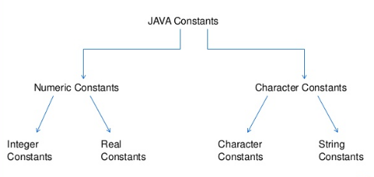
Variables and Constants in Java
Constants: Constant “literals” in Java refer to fixed values that do not change during the
execution of a program.
Java supports several types of constants given in figure below :
Integer
Integer Constants: Refers to a sequence of digits. There are three types of Integers, namely, decimal, octal and hexadecimal integer.
Decimal Integer consist of a set of digits, 0 through 9, preceded by an optional minus sign.
An octal integer constant consists of any combination of digits from the set 0 through 7, with a leading 0.
A sequence of digits preceded by ox or OX is considered as hexadecimal integer. They may also include alphabets A through F.

Slide 66
Variables and Constants
Real Constants: Integer constant are inadequate to represent quantities that vary continuously, such as distance, heights, temperature, prices and so on. These quantities are represented by numbers containing fractional parts like 17.546. Such numbers are called real.
The real number may also be expressed in exponential (or scientific ) notation. For example, the value 215.65 may be written as 2.1565e2 in exponential notation. e2 means multiply by 10². The general form is :
mantissa e exponent
mantissa is either a real number expressed in decimal notation or an integer. The exponent is an integer with an optional plus or minus sign. The letter e separating the mantissa and the exponent can be written in either lowercase or uppercase. Since the exponent causes the decimal point to “float”, this notation is said to represent a real number in floating point form.

Slide 67
Variables and Constants in Java
Single Character Constants: A single character constant (or simply character constant ) contains a single character enclosed within a pair of single quote marks. Examples of character constants are : ‘5’ ‘X’ ‘;’
String Constant: A string constant is a sequence of characters enclosed between double quotes. The characters may be alphabets, digits, special characters and blank spaces. Example are : “Hello Java” “1997”
* Constants in Java are not directly supported. Then how do you declare constants?
Variable: A variable is an Identifier that denotes a storage location used to store a data value. Unlike constants that remain unchanged during the execution of program. Examples of variables : average,height,total_height.
Variable name may consist of alphabets, digits, the underscore(_) and dollar characters.
Rules to write Variable/Identifier in Java :
They must not begin with digit
Upper and lowercase are distinct. This means that the variable Total is not the same as total or TOTAL.
It should not be a keyword.
White space is not allowed.
Variable names can be of any length.

Slide 68
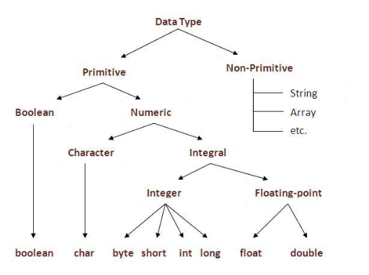
Data Types in Java

Slide 69
Integer Primitive Type
The Java integer primitive types.
Type | Bit Size | Minimum Value | Maximum Value
byte | 8 | -128 | +127
short | 16 | -32,768 | 32,767
int | 32 | -2,147,483,648 | 2,147,483,647
long | 64 | -9,223,372,036,854,775,808 | 9,223,372,036,854,775,807
Integer literals can be specified in decimal, hexadecimal, or octal notation. To specify a decimal
value, simply use the number as normal. To indicate that a literal value is a long, you can append
either "L" or "l" to the end of the number. Hexadecimal values are given in base 16 and include
the digits 0-9 and the letters A-F. To specify a hexadecimal value, use 0x followed by the digits
and letters that comprise the value. Similarly, an octal value is identified by a leading 0 symbol.

Slide 70
Integer Primitive Type Examples
Integer | Long | Octal | Hexadecimal
0 | 0L | 0 | 0x0
1 | 1L | 01 | 0x1
10 | 10L | 012 | 0xA
15 | 15L | 017 | 0XF
16 | 16L | 020 | 0x10
100 | 100L | 0144 | 0x64
Floating-Point Types
Support for floating-point numbers in Java is provided through two primitive types-float and double, which are 32- and 64-bit values, respectively.
Similar to integer literals are Java's floating-point literals. Floating-point literals can be specified in either the familiar decimal notation (for example, 3.1415) or exponential notation (for example, 6.02e23). To indicate that a literal is to be treated as a single precision float, append either "f" or "F". To indicate that it is to be treated as a double precision value, append either "d" or "D".
Java includes predefined constants, POSITIVE_INFINITY, NEGATIVE_INFINITY, and NaN, to represent the infinity and not-a-number values.
The following list shows some valid floating-point literals:
43.3F,3.1415d,-12.123f,6.02e+23f,6.02e23d,6.02e-23f,6.02e23d

Slide 71
Floating Point Types
Support for floating-point numbers in Java is provided through two primitive types-float and double, which are 32- and 64-bit values, respectively.
Similar to integer literals are Java's floating-point literals.
Floating-point literals can be specified in either the familiar decimal notation (for example, 3.1415) or exponential notation (for example, 6.02e23).
To indicate that a literal is to be treated as a single precision float, append either "f" or "F".
To indicate that it is to be treated as a double precision value, append either "d" or "D".
Java includes predefined constants, POSITIVE_INFINITY, NEGATIVE_INFINITY, and NaN, to represent the infinity and not-a-number values.
The following list shows some valid floating-point literals:
43.3F,3.1415d,-12.123f,6.02e+23f,6.02e23d,6.02e-23f,6.02e23d

Slide 72
Boolean and Character Literals
Boolean :- Java supports two Boolean literals-true and false.
Character Literals :-A character literal is a single character or an escape sequence enclosed in single quotes, for example, 'b'. Escape sequences are used to indicate special characters or
actions, such as line feed, form feed, or carriage return.
String Literals
Although there is no string primitive type in Java, you can include string literals in your programs. Most applications and applets will make use of some form of string literal, probably at least for error messages. A string literal consists of zero or more characters (including the escape sequences shown in Table 3.8) enclosed in double quotes. As examples of string literals, consider the following: "A String“,"Column 1\tColumn 2”

Slide 73
Escape Sequences
Sequence | Purpose
\b | Backspace
\t | Horizontal tab
\n | Line feed
\f | Form feed
\r | Carriage return
\" | Double quote
\' | Single quote
\\ | Backslash
\uxxxx | Unicode character

